Slide 1

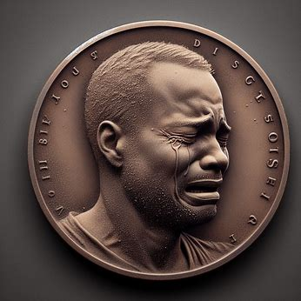
DUST COIN
Intersecting humour,storytelling and technology

Slide 2
INTRODUCTION
Dust Coin (DSTC) is a memetoken that brings humor and shared experiences of embarrassment and rejection to the blockchain
By leveraging the Internet computer network, Dust Coin aims to create a global, empathetic community through the innovative use of digital storytelling.
Vision To make blockchain as relatable and engaging as our shared human experiences. At Dust Coin, our vision is to create a blockchain ecosystem that fosters empathy, laughter, and community. Just as shared stories bring people together, we envision a platform that turns personal setbacks into collective growth and joy.
Mission To transform embarrassing and rejection stories into a source of humor and connection, fostering a global community. Our mission is to:

Slide 3
Problem & Solution
Problem Statement
The intricacies of crypto currencies are very complicated
Information overload
Lack of captivating/interesting educationalresources

Slide 4
Tokenomics
Total Supply: 50 Million DSTC Dust Coin's total supply of 50 million tokens ensures ample availability for a growing community while maintaining scarcity to drive value.
Distribution Breakdown
Community Rewards: 40% - To incentivize participation and engagement within the community.
Development Fund: 20% - To support ongoing platform development and innovation.
Marketing: 15% - To build awareness and attract new users.
Team: 10% - To ensure the team's continued commitment and alignment with the project's success.
Reserve: 15% - To provide a buffer for future opportunities and challenges.

Slide 5
Market Opportunity
Beginners
Crypto Enthusiasts
Educational Institutions
Investors

Slide 6
Go-to-Market Strategy
Brand Positioning
Content Marketing
Social Media Campaigns
Community Building
Partnerships and Collaborations
Product Integration
Public Relations
Sustainable Growth

Slide 7
Roadmap
June 2024
Platform Completion
Finish the platform to add interactivity so that stories can be interactive
July 2024
Tip and Get Tipped
Add feature to tip and get tipped on the platform.
August 2024
Distribution Plan
Award 5 Dusts for each story shared on our platform. Distribution handled by our backend canister.

Slide 8
Roadmap
September 2024
Presale Campaign
Partner with influencers for a presale campaign to provide liquidity.
October 2024
Tradable on DEXes
Dust will be tradable and swappable on decentralized exchanges.
Ongoing
Platform Improvements
Continual improvements of the platform.

Slide 9
Team
Amschel
Osuwo
Martin
Eugene

Slide 10
Impact and Sustainability
Charitable Initiatives
-Allocate 20% of profit towards mental health campaigns.
-Support various projects and organize inter-university memethons under ICP.
Social Impact Goals
-Promote financial literacy and inclusion through accessible crypto education.
-Engage in community-driven projects to foster a positive social impact.
ICP Mass Adoption
-Leverage Internet Computer Protocol (ICP) for secure, scalable, and decentralized solutions.

